Slide 1


Business Analytics

Slide 2
Business Case Analysis. Play Time for Kids

Slide 3
Value Chain Analysis

Slide 4
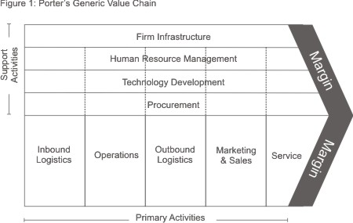
Value Chain. Play Time for Kids.
Primary Activities.
Inbound Logistics. This is not a necessary activity in the business model of this company.
Operations. activities to make the service work: management of the premises, management of the facilities, etc.
Outbound Logistics. This is not a necessary activity in the business model of this company.
Marketing & Sales. from the definition of new services and the price of each one, to the promotion and creation of sales channels that are not only direct but also through distributors and other channels. Follow-up and execution of the sale including underwriting functions.
Service. customer service once they are on the premises and handling of complaints, etc.
Secondary Activities.
Procurement. All purchasing activities of products and services necessary to provide service to customers.

Slide 5
Strategy Formulation. Play Time for Kids.
Motor Factors of Business Analytics | Impact in Data Monetization
Structured Data: More detailed transactional data: TPV, Credit Card… | We are now using our technology to manage structured data and improve our operational management. This management does not bring us much value in the marketing function. The decision is to keep doing it as we have been doing it up to now.
Unstructured data: various internal data (e-mail, consumer comments) and external data (social media, mobile). | We are not capturing unstructured data from our customers. We don't have in-house technology and capabilities but it's a great marketing opportunity. We also don't know how they can improve our operations but it sure is an opportunity.
Data rate: access to low latency data ("real-time") | Being able to improve our real-time analytics capabilities can be an opportunity for our operations and could represent a marketing opportunity... but we don't know how to measure it.
Predictive analytics: Causality, predictors, instrumentation, experimentation | No one has mentioned the ability to make predictions using massive internal and external data. This means that our company is not ready for this change. It is far beyond our current capabilities but not doing so is a very high risk in the market.

Slide 6
Thank You

